Slide 1

75% of Internet Users
SaaS
PaaS
IaaS

Slide 2
Citrix NetScaler
NetScaler
MPX
Scales the virtual datacenter
Accelerates, secures, delivers
Powers the web and cloud

Slide 3
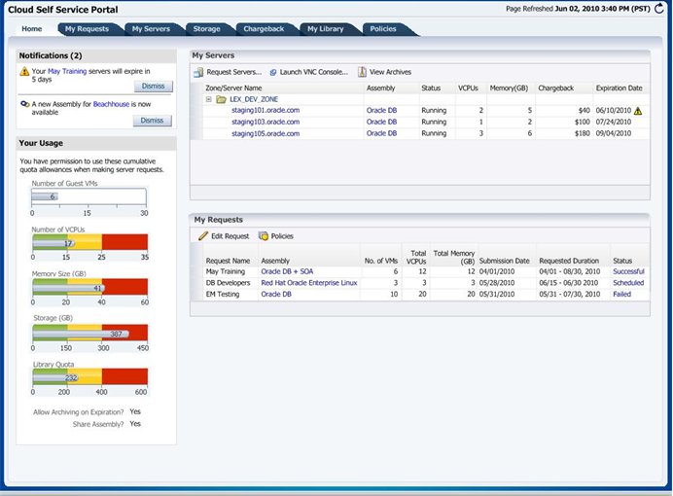
Paas Equals Apps Not Infrastructure

Slide 4
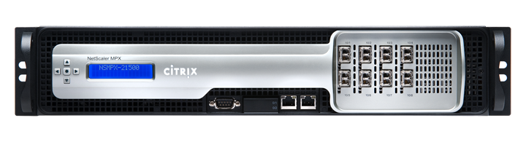




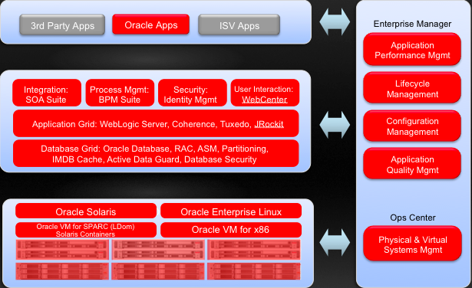
NetScaler Delivers PaaS
Availability
Performance
Offload
Security
Notes:
NetScaler enhances the deliver of your customers web applications across four principle dimensions (click). These include Availability, Performance, Offload, and Security; all built on a common IT interface and providing an excellent ROI.
Within each feature category there are numerous techniques (CLICK) delivered by NetScaler and I will elaborate on each.
Customers gain:
100% application availability via our world-class L4-L7 load balancing capabilities and intelligent service health monitoring features
Accelerated application performance by 5x through static and dynamic content caching and compression
An average of 60% in application infrastructure savings through connection pooling and offloading SSL processing from servers; this is especially important for Web 2.0 applications
End-to-end application security with integrated Access Gateway Enterprise for secure remote access and an application firewall for protection against application layer attacks
4

Slide 5




Enabling Cloud Elasticity

Slide 6

Oracle Cloud API
1. NetScaler senses increased load
‘<App Assembly>/?scale=up’
2. NetScaler calls Cloud APIs
3. App-centric call made
4. PaaS cloud adds capacity
Application Grid
5. NetScaler uses new capacity
Database Grid

Slide 7

Enabling Cloud Elasticity
Burst
Application Workload
Capacity Threshold
Elastic Scaling
Time

